Slide 1
E-Commerce Cloud Infrastructure
Group 8 (Andy, Syahir, Zaki, Zell)
Notes:
Good Afternooon all, we are group 8 comprising of Andy, Me, Zaki and Zell and today we will be presenting our e-commerce system on cloud infrastructure solution.
I will begin by establishing the situation, obstacles, cloud architecture, Andy will elaborate the services/products utilised, Zell shall elucidate the security features and Zaki will end of by showcasing the proof of concept.

Slide 2
BACKGROUND
Medium-sized apparel enterprise based in Singapore, which aims to transition from on-premise to cloud-based infrastructure due to its scalability and suitability.
Meet current demand and facilitate regional expansion. Struggles with managing high traffic during peak periods.
Has faced security breaches, including credit card fraud and identity theft.
Notes:
So the scenario is as such, a medium-sized apparel company who is based in Singapore, that is currently using open-source solutions and on-premise infrastructure has intention to migrate its e-commerce platform to the cloud to keep up with its current demand and put in place its regional expansion plans.
They have discuss they have issues with coping high traffic flow during peak seasons such as festive holidays and product launches.
The company have shared they have experienced being hacked before and that their users succumbed to credit card fraud and identity theft.

Slide 3
PROBLEMS ENCOUNTERED
Web Traffic Overload: Coping with abrupt surges in web traffic became overwhelming, leading to website crashes and decreased performance.
Compromised Security: The existence of security vulnerabilities resulted in instances of personal data breaches, undermining customer confidence and trust.
Financial Strain: The substantial expenses tied to establishing and managing on-premise infrastructure imposed a significant financial burden.
Feature Constraints: Shortcomings encompassed the absence of advanced functionalities like real-time analytics, automated marketing, and efficient customer support.
Notes:
The problems they face can be derived by precedence that have been set, which includes:
Inability to handle sudden spikes in web traffic oftentimes resulting in website crashing and performance degradation.
The presence of security loopholes resulted in personal information being compromised and eroding customers trust.
On top of that, the high cost associated with building and maintaining on premise infrastructure has a monetary toll.
Not forgetting as well, the limited features available so they are sequestered from advanced capabilities such as real-time analytics, automated marketing and streamlined customer support.

Slide 4
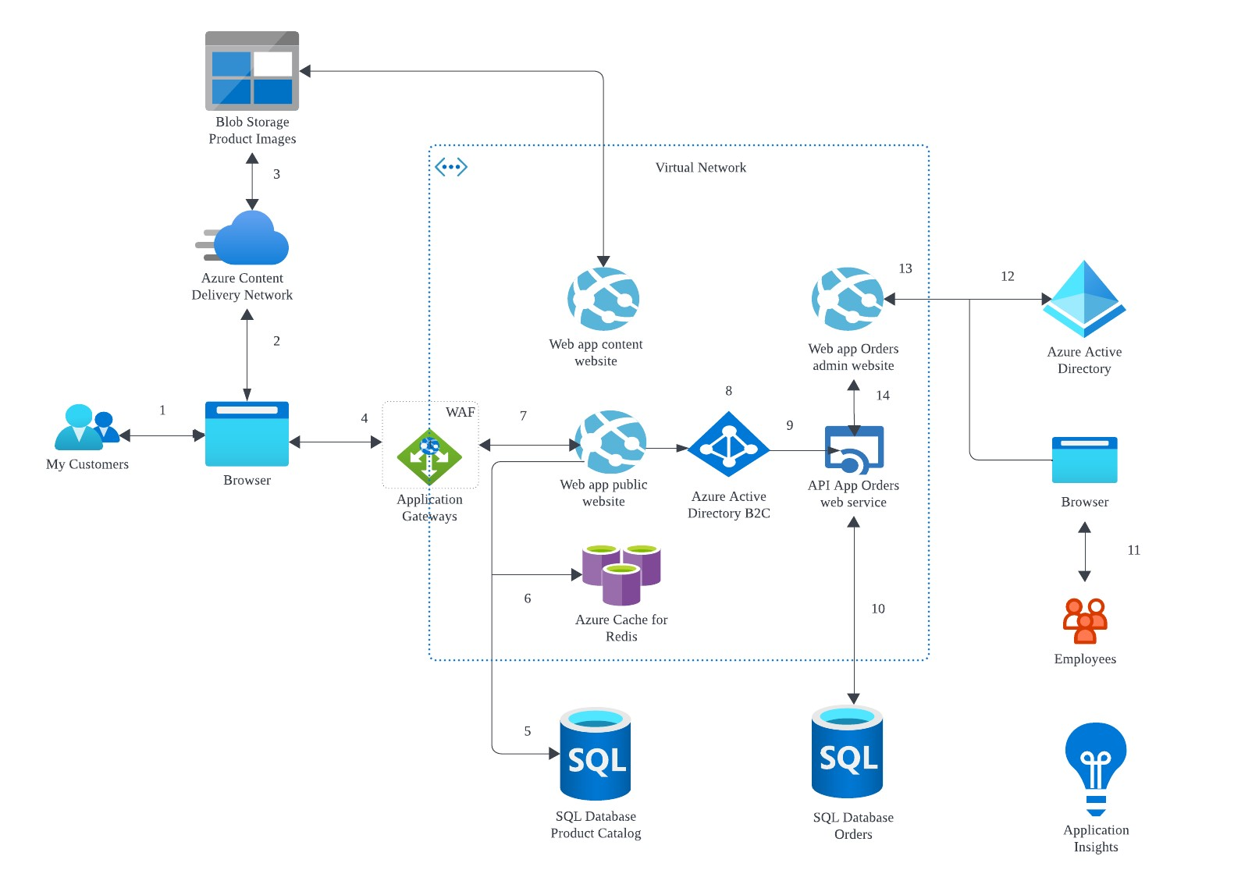
PROJECT ARCHITECTURE OVERVIEW
Notes:
So this slide outlines the cloud architecture. So we shall go through the steps sequentially.
Customer access public website in the browser.
Browser pulls static resources and product images from CDN.
CDN pulls product images from blob storage.
Customer searches for products
Public website pulls product catalogue from one of the database.
Page output is cached.
Customer orders after authenticating against Azure Active Directory B2C.
Public website invokes order web service.
Orders web service saves/loads orders from the other database.
On the other end, employee access admin web in the browser.
Authenticate against Azure AD.
Employee searches the orders
Admin website invokes the orders web service.
I will pass my time to Andy now to delve deeper into the components of the architecture.

Slide 5
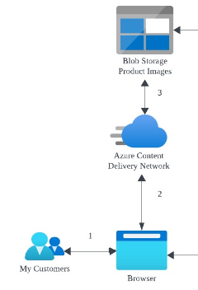
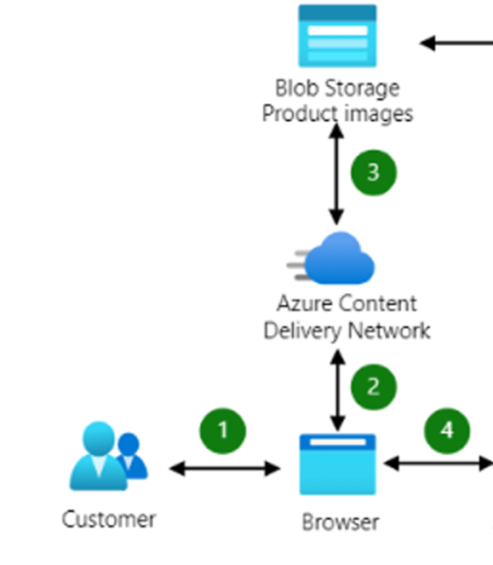
WHY WE CHOSE THESE SERVICES
Azure Content Delivery Network
Cache product images from blob storage to POP locations closer to customer to improve performance and help reduce latency
Azure Blob Storage
Set up a single blob storage account which will be used to store the product images for the e-commerce business
Offers security features such as encryption and access control
Notes:
Thank you Syahir!
Firstly on the left side we have the Azure Content Dellivery Network which is used for caching the product images from blob storage to point of presence location closer to the customer to reduce latency.
Then we have the Blob Storage which will be used to store static images and also provide security features such as encryption and access control.
Moving on to the next slide~

Slide 6
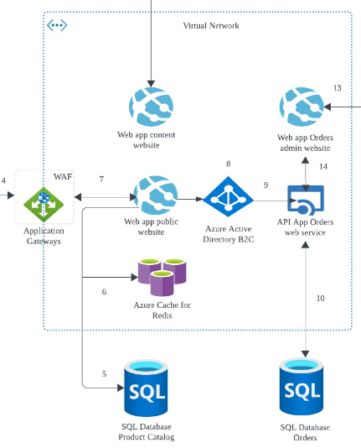
WHY WE CHOSE THESE SERVICES
Azure Application Gateway
A load balancer that will manage the traffic to the web applications
Built-in WAF that helps to protect the web app from common attacks such as SQL injection and cross-site scripting (XSS)
Azure App Service
Virtual Network: A isolated environment where each resources can securely communicate with each other while prevent data leakage, unauthorised access and network attacks
Public website: Enables interactive browsing of products and making payment
Content website: Manage and presenting of product content that the public will be able see
Admin website: A back-end system to handle payment, tracking of orders, customer service and administration
API App (Orders web service)
Managing, processing and tracking of orders
Integrate with third-party services such as payment gateways and shipping providers
Notes:
The Application Gateway, that distribute and share the traffic across multiple servers which will improve the performance of the web applications as it prevent traffic spiking It also have a built-in Web Application Firewall which will protect the web app from common attacks such as SQL injection or cross-site scripting
Next we used the Azure App Service to create mainly 3 websites for different purposes (public,content and Admin)
With the help of the API App.
Azure Active Directory (B2C)
Securely manage identity of customers
Support integration with social identity providers (Facebook and instagram)
Moving on to the next slide~~

Slide 7
WHY WE CHOSE THESE SERVICES
Azure Cache for Redis
Cache web output allowing users to access and load the web page faster
Reducing workload on the backend databases or services
Azure SQL Database
Product Catalogue database:
Store product information such as the description, pricing and the stock status
Orders database:
Store information such as customers address and credit card information
Notes:
At the bottom we have Azure cache for Redis which is used to cache the frequent accessed data such as product catalogs which will reduce the number of times that data needs to be retrieved from the database. This help to improve the web performance.
Then we have two distinct SQL databases which stores different data
Easier to manage
Prevent any sensitive data loss/leakage such as the customer address and credit card information.
Next slide~~

Slide 8
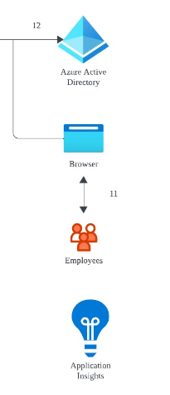
WHY WE CHOSE THESE SERVICES
Azure Active Directory
Enhance security using multi-factor authentication
Azure Application Insights
Monitor and improve using collected data and provide insights on how the application is performing
Diagnose and troubleshoot issues to prevent performance degradation
Notes:
Here we also have the Azure Active Directory which is connected to the admin site
Using the MFA feature. It is able to prevent unauthorized access
Reduce the risk of data breaches
It also help the organisation to comply with any security regulations
Lastly, the application insight serve the purpose of monitoring collected data on how the application is performing and improve the overall performance when necessary
It is also capable of diagnosing and troubleshoot issues to prevent performance degradation
I will now pass on to zell to talk about the security features.

Slide 9




SECURITY FEATURES
Azure Active Directory B2C
AD B2C Key feature - Customers use either local account or their preferred social, enterprise identities to get single sign-on access to the Web App and APIs.
Federate with identity providers that support OAuth 1.0, OAuth 2.0, OpenID Connect, and SAML (Security Assertion Markup Language) protocols
Azure AD B2C defines several types of user accounts. Both Azure Active Directory and Azure Active Directory B2C share these account types.
Stores all users' credentials, profile data, password and application registrations
Control sign-in , Sign-up options, set permission rights and set conditional access if necessary
Tenant (Client’s Organisation)
Work accounts
Guest accounts
Consumer accounts
Notes:
On this section I will be sharing about the security features
One of the service I will be highlighting will be Azure Active Directory & Active Directory Business 2 Customer
They are build on the same technology but serve slightly different purpose.
Key Feature
Why
Describe types of account
Keyword for next page is “next slide please”

Slide 10
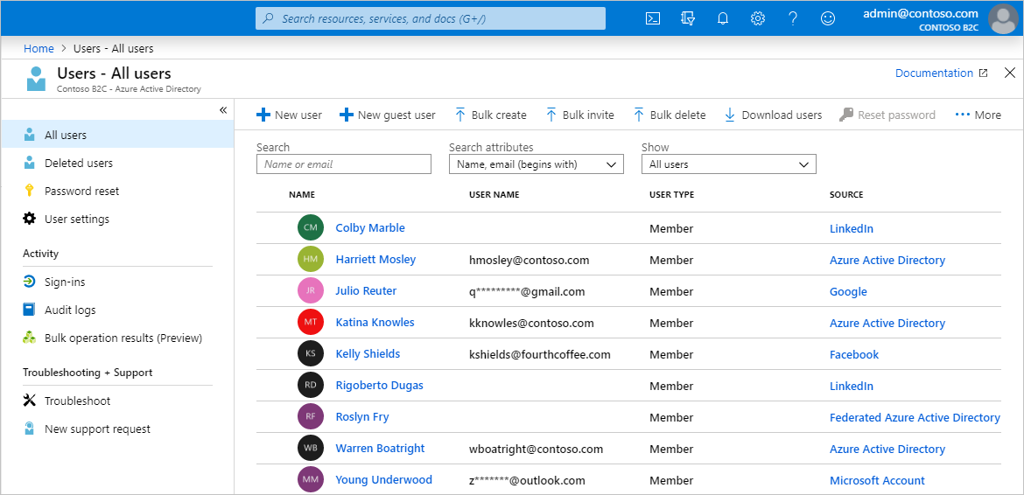
SECURITY FEATURES
Back End
Users with Work accounts
-Have administrator role, and manage resources in a tenant
-Can create new consumer accounts, reset passwords, block/unblock accounts
-Set permissions or assign an account to a security group.
Notes:
On this page it shows a simple overview on Azure AD B2C
Keyword for next page is “next slide”

Slide 11
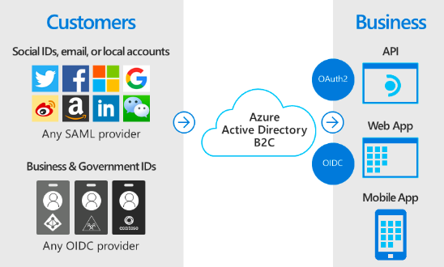
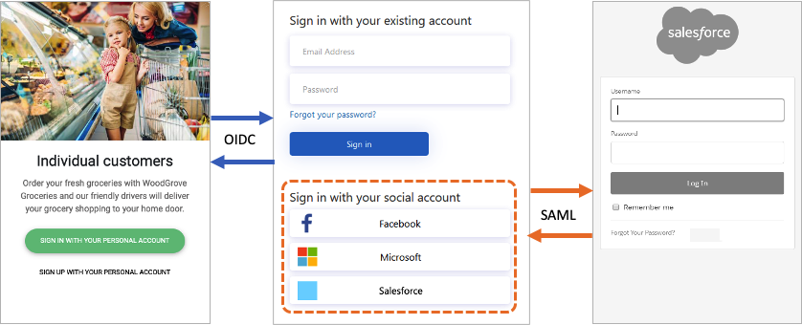





SECURITY FEATURES
Azure AD B2C provides various ways in which you can authenticate a user
Allow users to sign in to the web application with local account or using credentials from social and enterprise identity providers
Employee Account
Logged in using Azure AD registered username & password
Additional Multi-factor authentication (MFA)
Notes:
Now for the front end
As mention, Azure AD B2C provides various ways in which you can authenticate a user
Consumer can choose to log in, with the username and password stored locally in the Azure AD B2C directory. "local accounts."
Social or enterprise identities, where the identity of the user is managed by a federated identity provider. For example, Facebook, Google, Microsoft, ADFS, or Salesforce.
[The difference]
[OpenID is simpler to use and implement because there is no XML language
OIDC is lightweight and more performance-friendly than SAML. For large enterprises that require a higher level of security, SAML might be the better choice. SAML allows multi-factor authentication
Extensible Markup Language (XML) lets you define and store data in a shareable manner. XML supports information exchange between computer systems such as websites, databases, and third-party applications.]
The reason for this additional feature is to ensure only authorised employee can access the admin/employee domain
Keyword for next page is “next slide please”

Slide 12
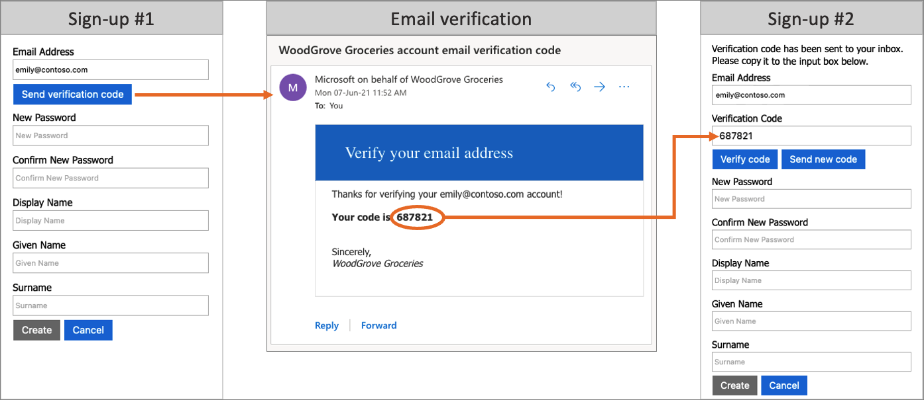





SECURITY FEATURES
Sign up option - Email & OTP Verification
Azure AD B2C ensures valid email addresses by requiring customers to verify them during the sign-up, and password reset.
Prevents malicious actors from using automated processes to generate fraudulent accounts in the applications.
Notes:
Finally on this page we will touch on the Email & OTP verification
For new user, they will be prompted to do a registration and enter their email address
Verification code/ OTP will be send to their registered email and they will need to enter the verification code/OTP to complete the registration
This is done so to ensure that the email account is authentic
Prevents malicious actors from using automated processes to generate fraudulent accounts in the applications.
In the worst scenario, if the registered emails are not verified. Malicious user can flood the database with fake accounts. Resulting in higher storage > higher price
“ I will now invite my classmate Zaki to brief on the next section “Proof of Concept” “

Slide 13
PROOF OF CONCEPT
Login Page
Customers: Azure AD B2C
Employees: Azure AD with MFA enabled
Web App
Public/Content Website
Admin Website
Database
Integrated with Web App
Notes:
Thank you Zell. Now I will be talking and showing our proof of concept. It will consist of the login pages, the web apps and their integration with the API Apps and SQL Database. For our POC, I will be demonstrating from both points of view of the customer and the employee.

Slide 14
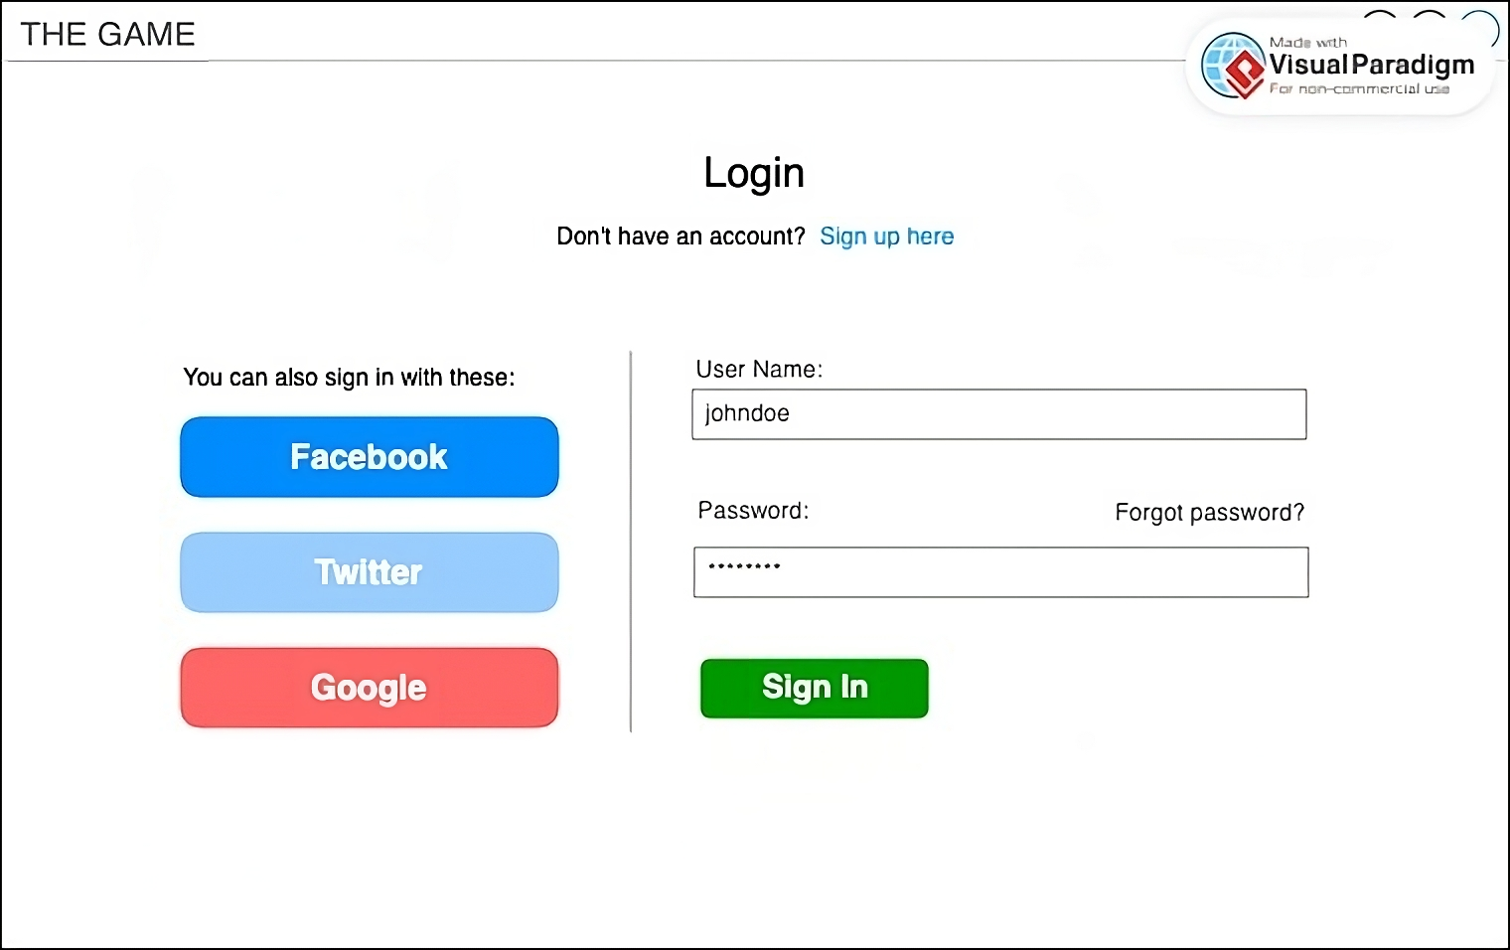
LOGIN PAGE FOR CUSTOMERS
Notes:
Firstly, this is how the login page will look like for the customer. As you can see, they have the choice of using the local account in the Azure Account B2C or use other social identity providers such as Google and Twitter accounts to log in. This is quite a common practice for e-commerce platforms or businesses that we felt we should adopt for our system. We will not enforce logging in for them to access the web app for casual browsing or window shopping in this case. They could do so if they want to see personal information such as their purchasing history or to get tailored recommendations. However, they will be prompted to do so once they want to make a purchase during the checkout process. The self-service password reset will be enabled for convenience and to incur a lower technical overhead. We chose this IAM method for this system so that the customers will undergo a better user experience which delivers speed while implementing security for the customer data.

Slide 15
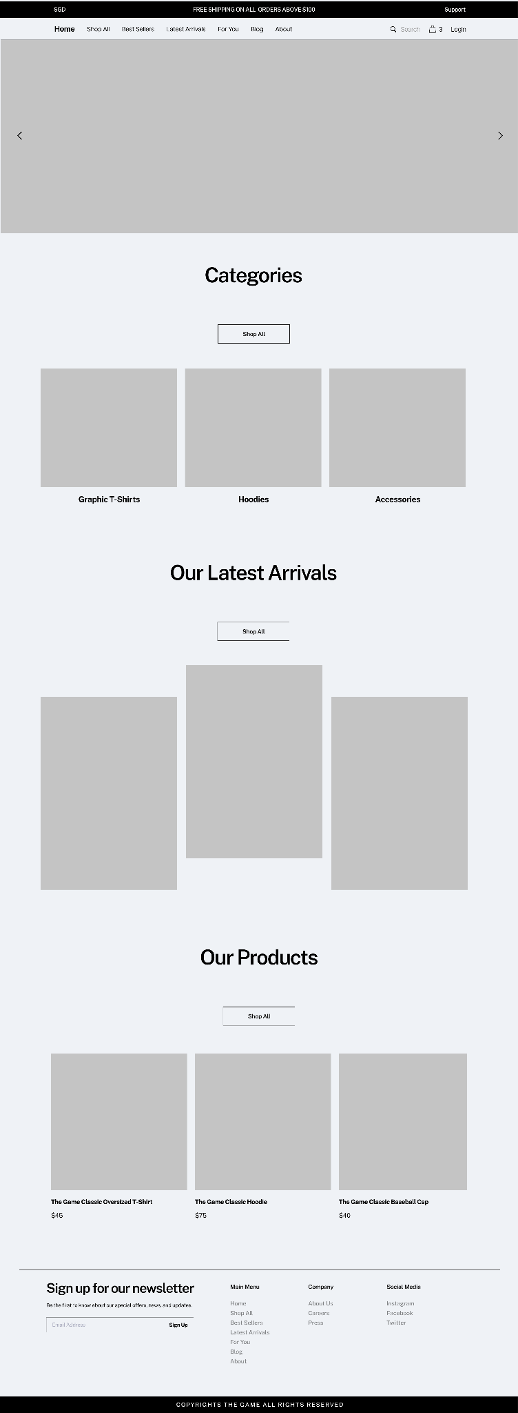
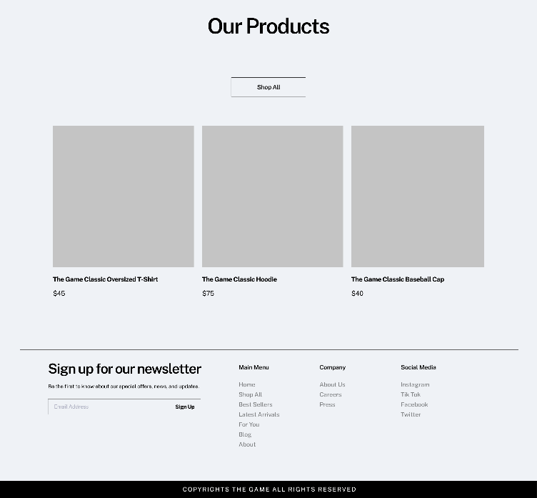
WEB APP - HOME PAGE
Header
Body
Footer
Notes:
Secondly, once they have accessed the web app, the home page of the public website will look like this. We included in the header links to view all the products or view the latest arrivals. The header will also include other content such as the blog or the For You page which provides tailored recommendations for the customer based on their order history and profile. In the body of the home page, we can see some categories or items which are part of the latest arrivals to create a more visual experience for the customers. In the footer, there will be links to the various social media platforms of the company.

Slide 16
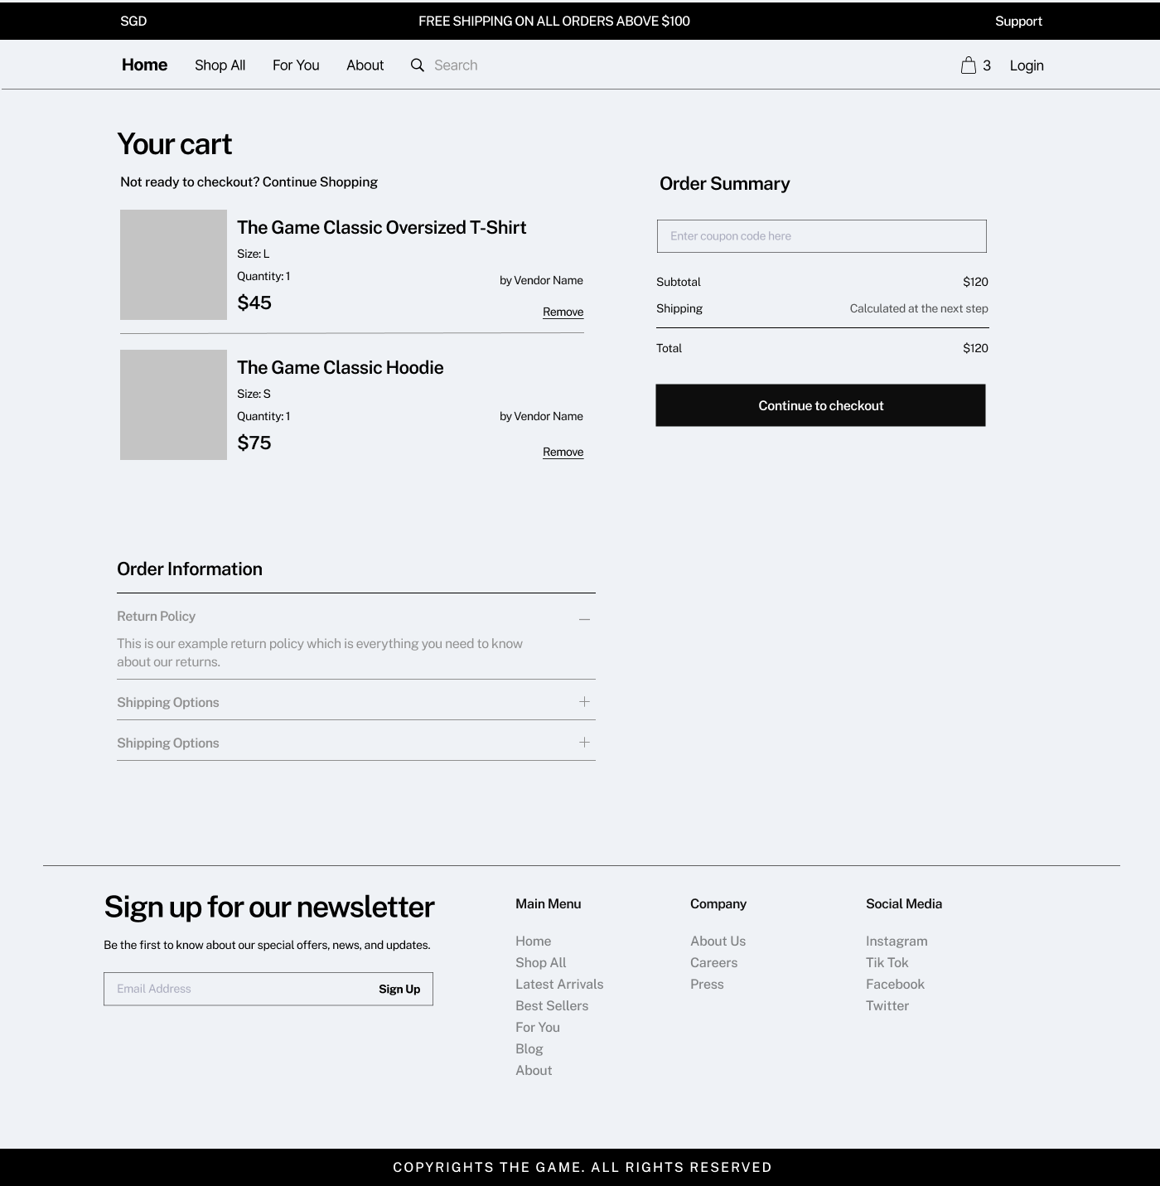
WEB APP - CART PAGE
Notes:
Additionally, this is an example of how the cart page will look like so that customers will be able to see what they are planning to purchase before going through the shipping and payment process. They will be prompted to log in once they continue to check out their items.

Slide 17
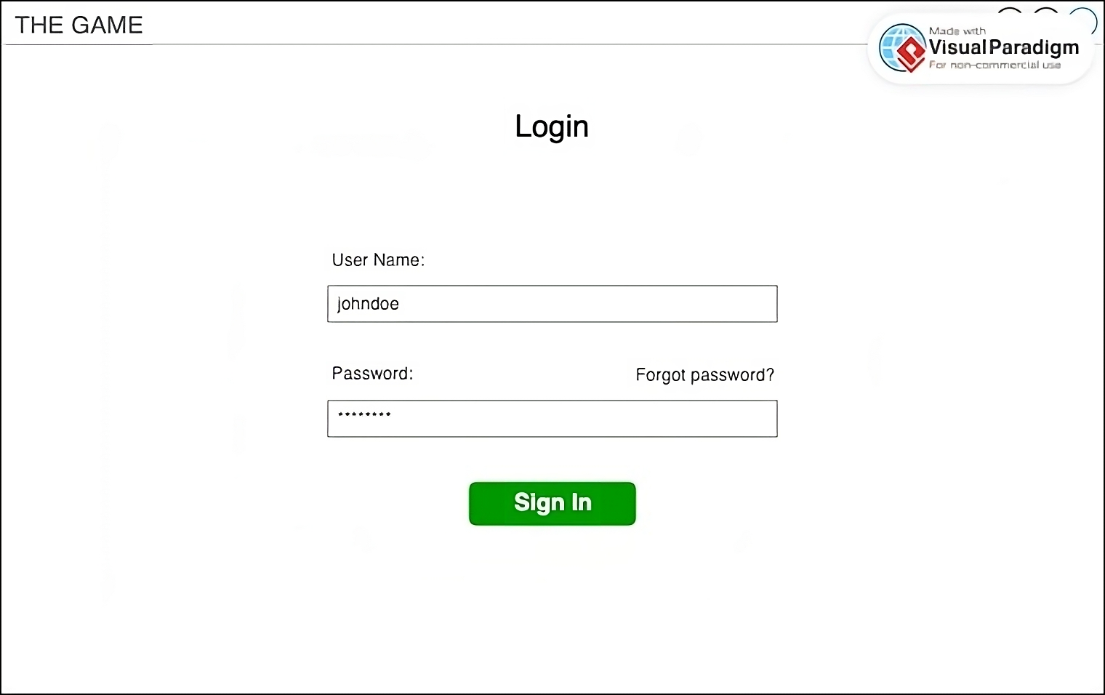
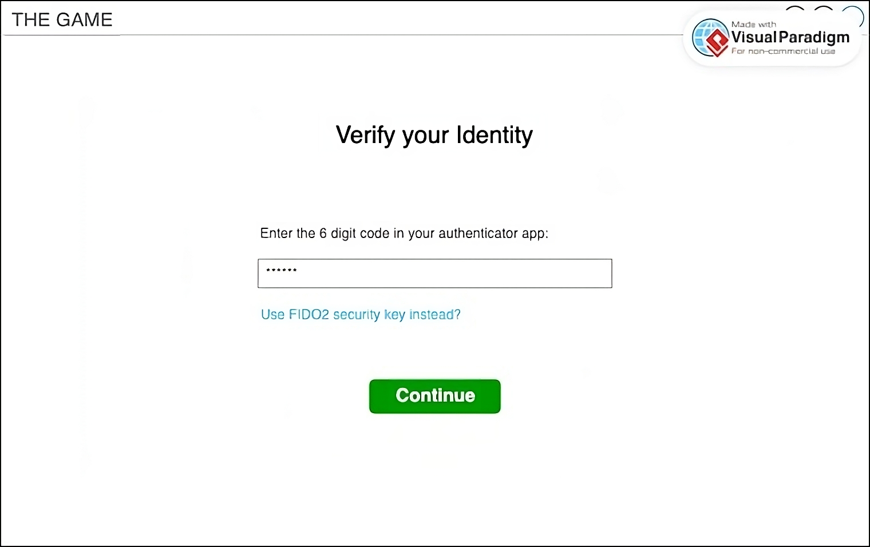
LOGIN PAGE FOR EMPLOYEES
Log in using Azure AD account
Complete the MFA process
Notes:
On the other hand, this is how the login page will look like for the employee. They will have to log in using their local account in Azure AD then be prompted for the MFA. They can either choose to use an authenticator app such as Microsoft Authenticator to key in their 6 digit code or their FIDO2 security key for this process. Similar to the login page for customers, the self-service password reset will also be enabled. In the backend, there will be a Conditional Access policy in play to only allow devices under Azure AD Joined to access the web app. This login page will be initiated when accessing the Admin Orders web app which is only authorised for employees to take charge of the order management and administration.

Slide 18
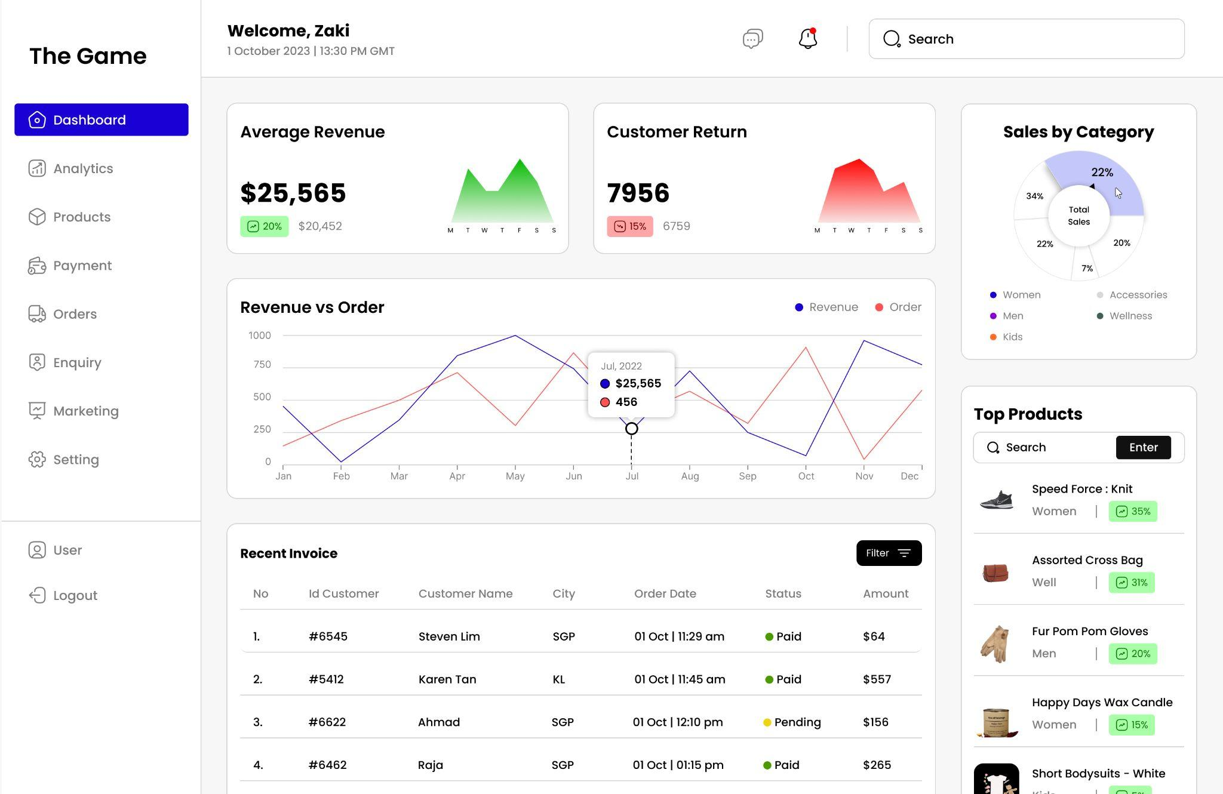
WEB APP - ORDERS ADMIN WEBSITE
Dashboard
Notes:
Once logged in, this is how the Admin Orders web app will look like. It provides a dashboard view of information such as billing, analytics and invoices which are confidential information only to be seen by employees of the company. As you can see, the information on the dashboard makes use of API calls to take in real-time data from the SQL Database which stores the order information such as order ID, name of account holder and amount spent. This is an example of how the Web app and API Apps both part of the App Service as well as the SQL Database are integrated in this cloud infrastructure for a seamless administrative experience for the employees.

Slide 19
THANK YOU
Notes:
That is all for our presentation. Thank you.

Slide 20
Q&A

